Slide 1
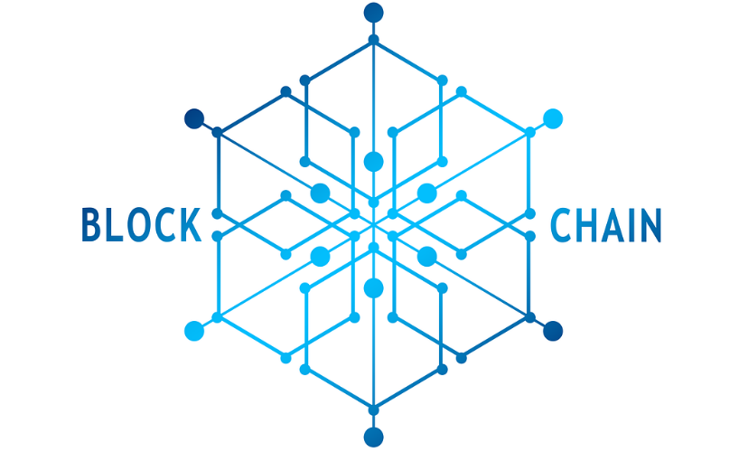
Full Stack Web Application For Consortium Blockchain
Faculty Advisor
Dr. Kewei Sha
Mentors
Dr. Kwok Bun yue
Joses Selvan
Team
Vivek Kukkapalli
Srikar Vuppala
Aravind Yakasi
Tarun Jandhyala
Ravi Teja Nakkala

Slide 2
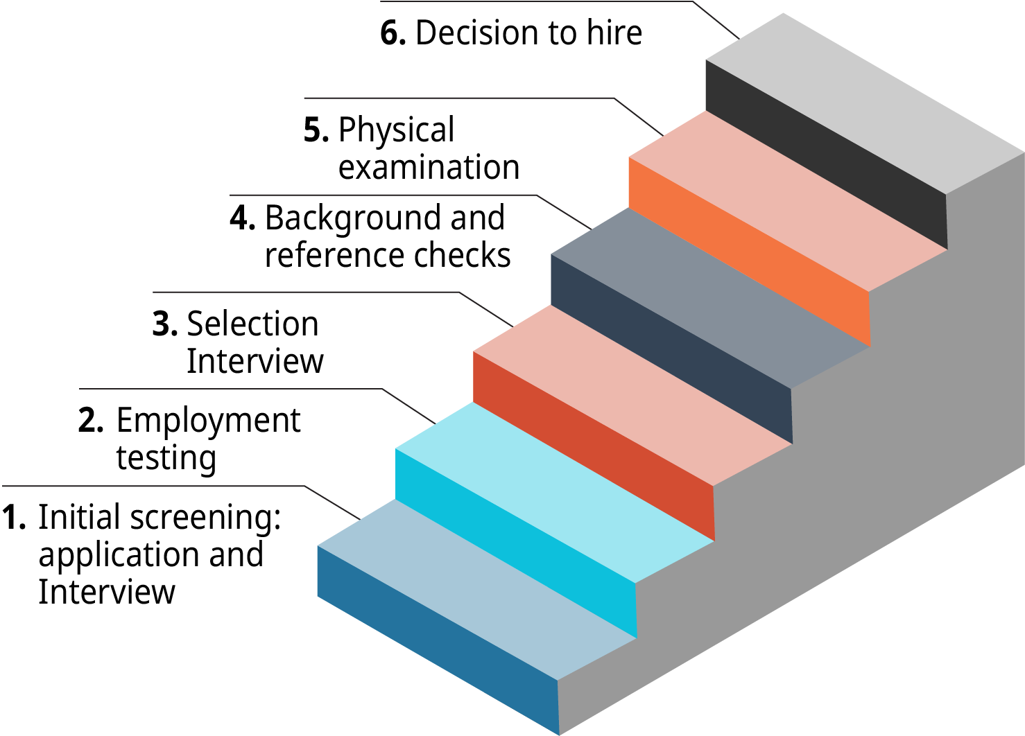
Overview
6. Conclusion
5. Future Scope
4. Milestones Achieved
3. Design & Implementation
2. Introduction
1. Problem Statement
11/29/2022
Full Stack Web Application For Consortium Blockchain​

Slide 3

Problem Statement
The objective of this project is to create a full-stack web client application that can interact with blockchain network and recreate business process used by organizations to develop sophisticated systems utilizing MBSE process
11/29/2022
Full Stack Web Application For Consortium Blockchain​

Slide 4

Introduction
Blockchain is an innovative distributed global ledger technology that has caught the interest of both business and academia
It offers efficient data storage, immutability, traceability, tamper resistance, and transparency for data that can act as a general ledger for a variety of application areas
11/29/2022
Full Stack Web Application For Consortium Blockchain​

Slide 5
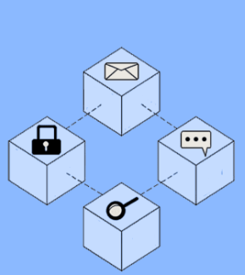
Terminology
Local User
Normal Organizational user with organization specific functions
Fabric User Identity
User Identity created in block chain network to work with smart contracts and other operations
A local user is mapped to Fabric User Identity
11/29/2022
Full Stack Web Application For Consortium Blockchain​

Slide 6
Terminology
Fabric Role
Fabric role defines the level of fabric user identity i.e., each role has specific set of operations
Example: client, peer, etc.
The Fabric CA
Certificate Authority registers identities, issues enrollment certificates, and offers certificate renewal and revocation services
11/29/2022
Full Stack Web Application For Consortium Blockchain​

Slide 7
Project Scope
Building a secure full stack web client app to communicate with a blockchain network is the aim of this project
Using the MBSE method to duplicate the organizational business process for developing complex systems
This client application helps to harness blockchain technology in building trust and manages real-world organization roles and responsibilities
UI(Angular), APIs (Nodejs), database (Postgres), and blockchain
11/29/2022
Full Stack Web Application For Consortium Blockchain​

Slide 8
Requirements
Software
Hardware
Angular 13
PostgreSQL 13
Blockchain Network (Fabcar)
Git
GitHub
Node 16
Operating System - Ubuntu 20.04.1 and Windows 64bit.
Processor - 2 GHz dual core
System Memory - 4 GB Ram
Hard Drive Space - 50 GB
Graphics - VGA capable of 1024×728 resolution
USB or CD/DVD Drive - At least one available for installer media
Internet Adapter - Wired or wireless network
11/29/2022
Full Stack Web Application For Consortium Blockchain​

Slide 9

Design & Implementation
11/29/2022

Slide 10



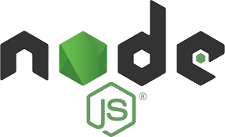
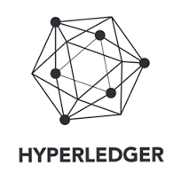
Architecture Flow
Backend
Web UI
Roles: Admin
User
MBSE APIs
Database
Actor
Blockchain
Hyperledger Fabric
11/29/2022

Slide 11
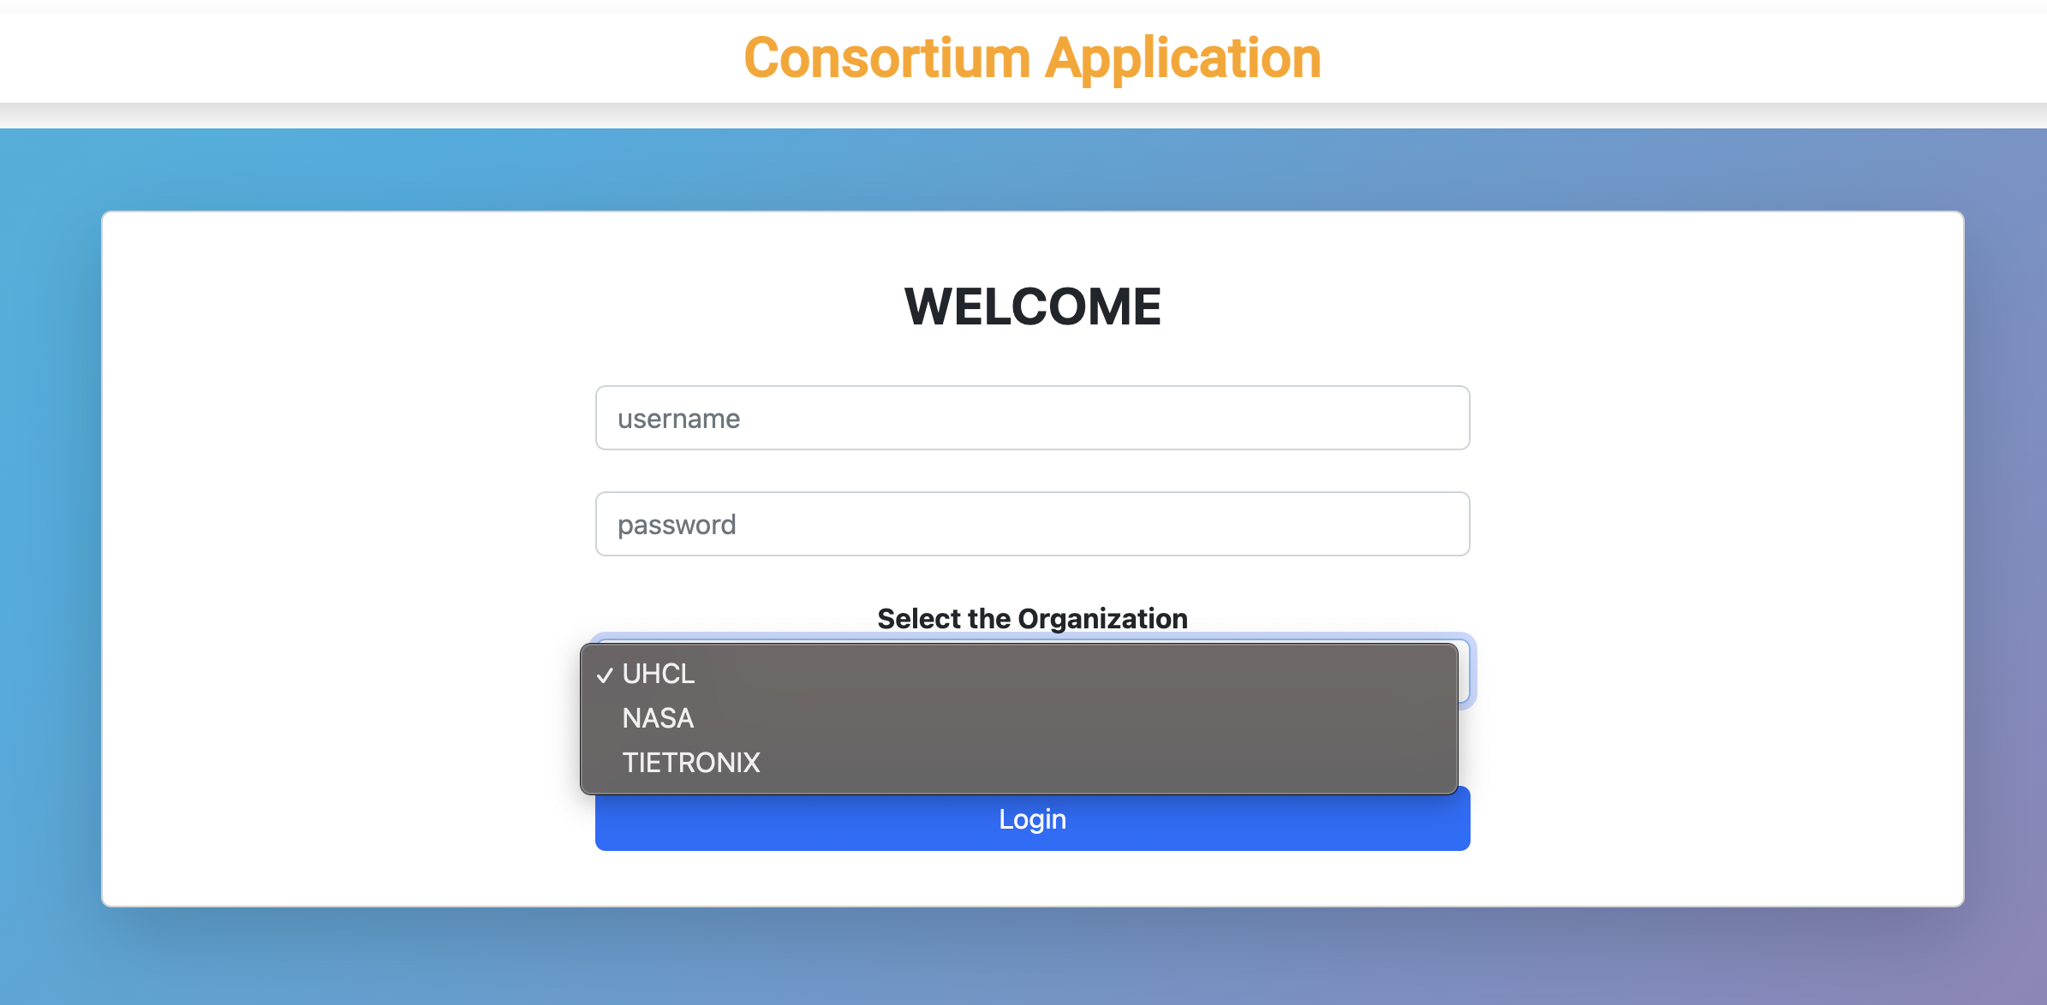
Login Screen
11/29/2022
Full Stack Web Application For Consortium Blockchain​

Slide 12
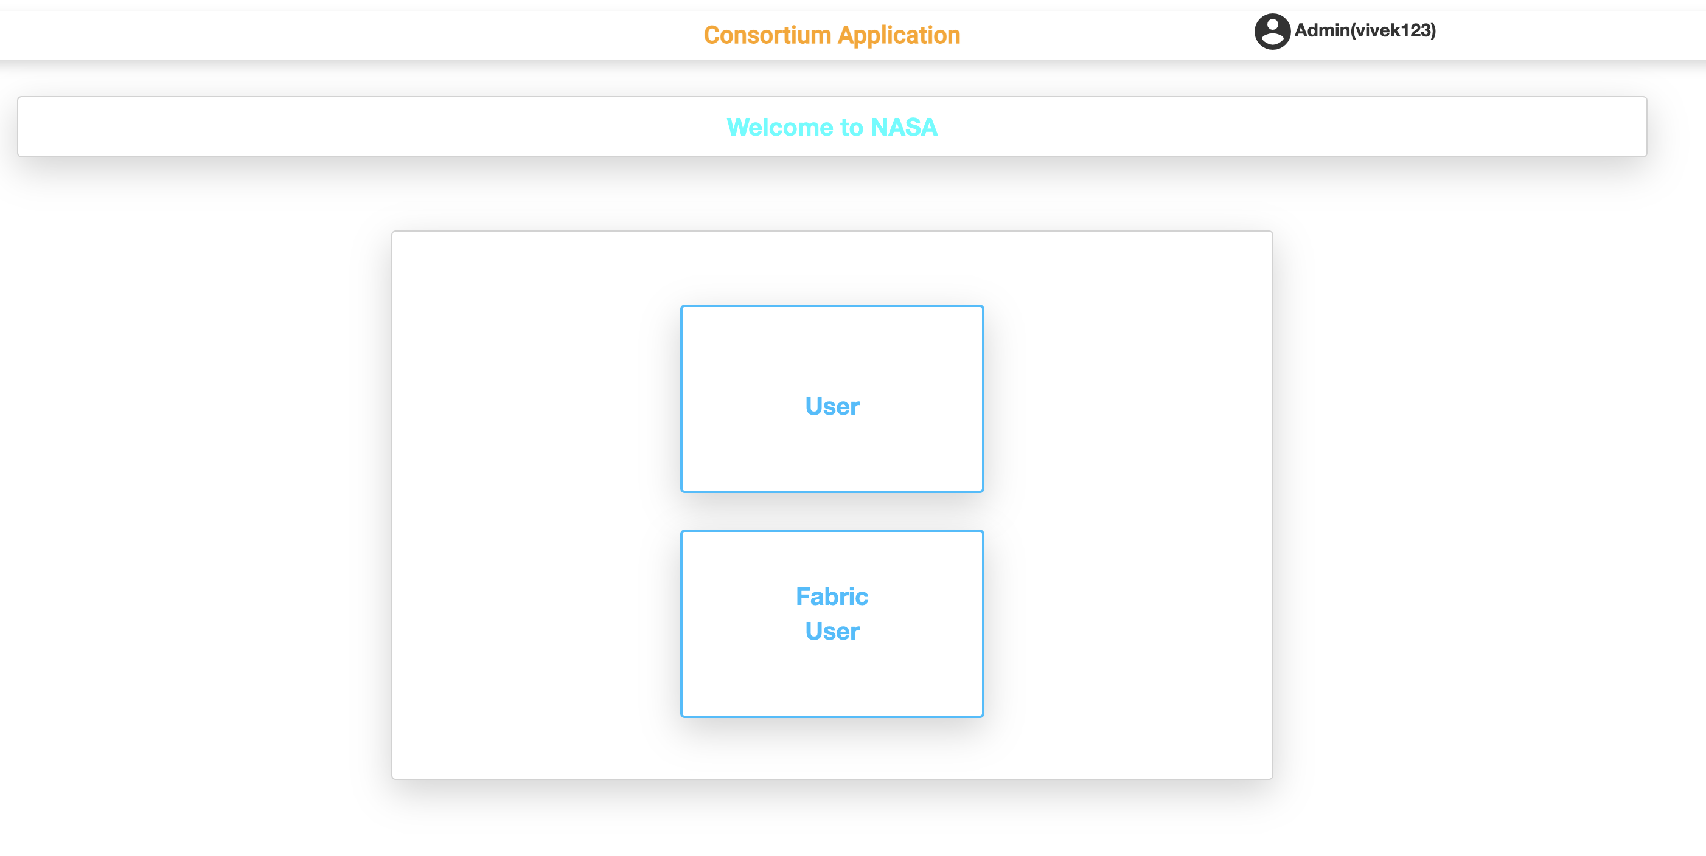
Admin Dashboard
11/29/2022
Full Stack Web Application For Consortium Blockchain​

Slide 13
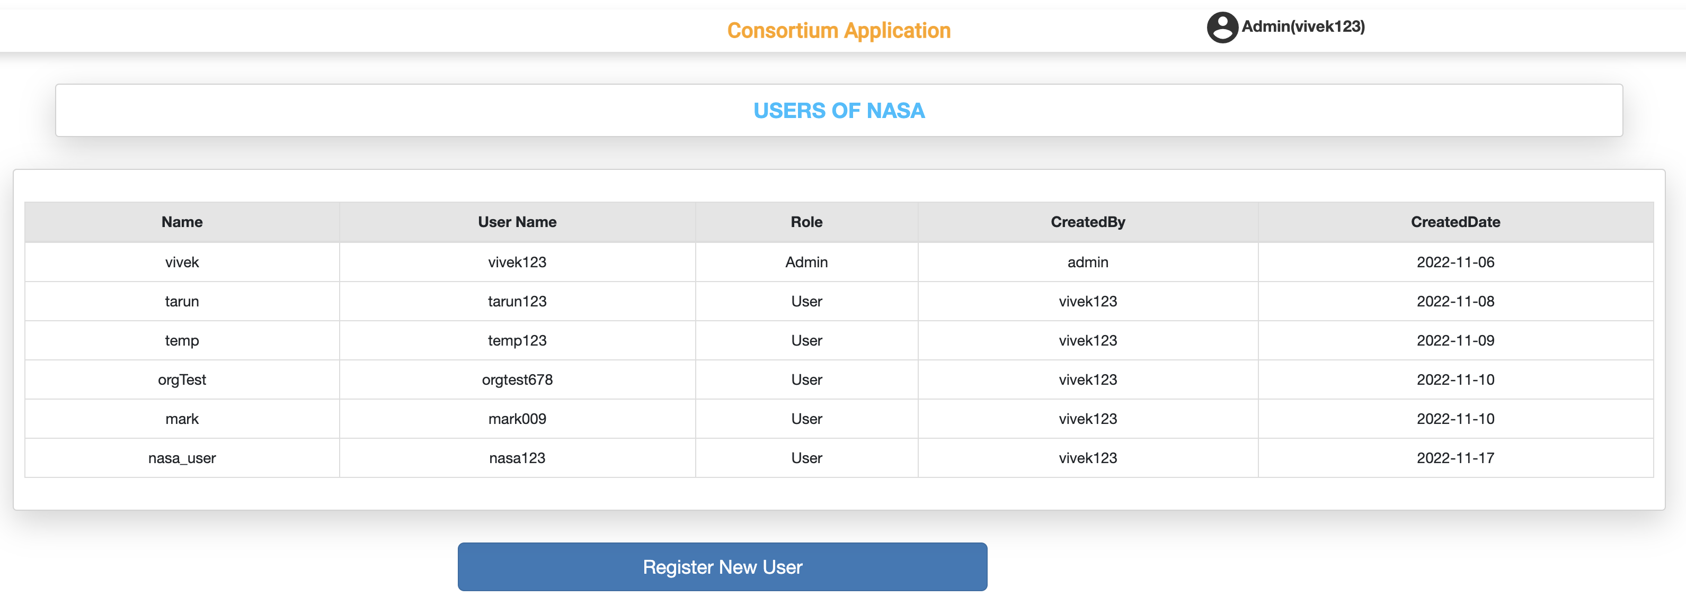
Local Users List
11/29/2022
Full Stack Web Application For Consortium Blockchain​

Slide 14
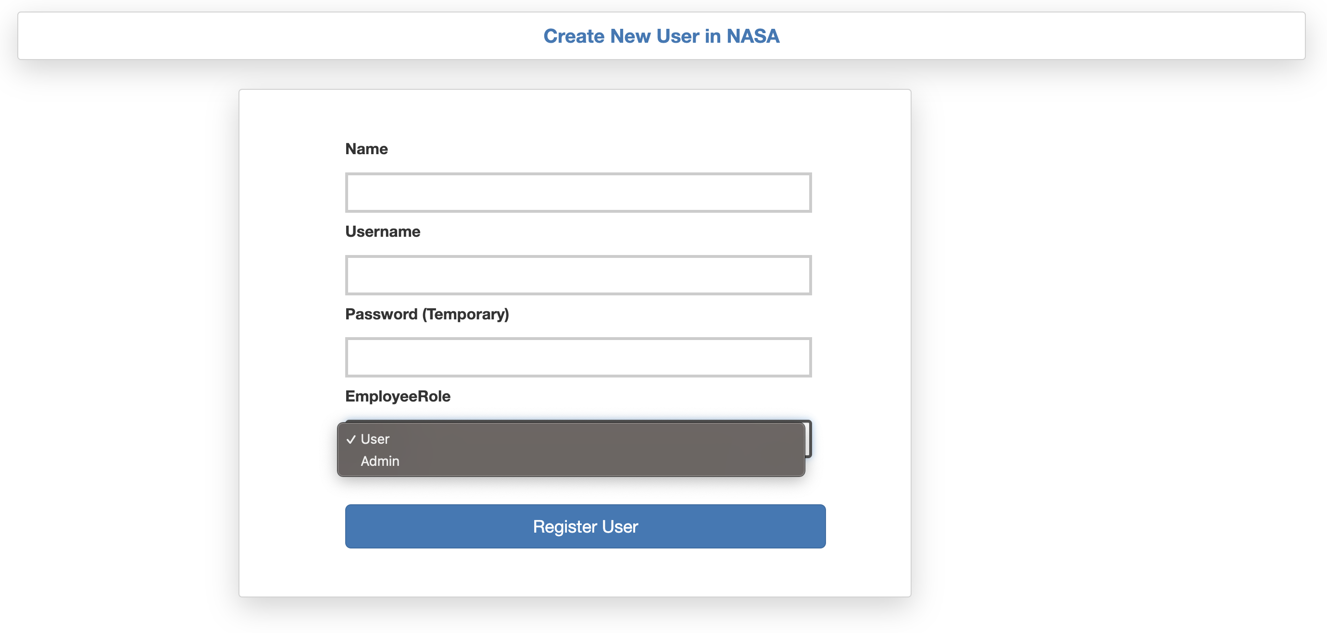
Create User/Admin
11/29/2022
Full Stack Web Application For Consortium Blockchain​

Slide 15
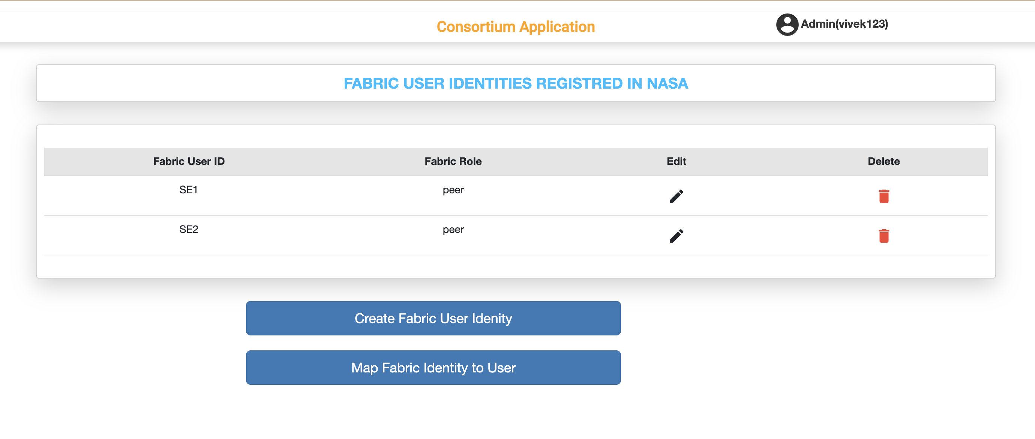
Fabric User Identity List
11/29/2022
Full Stack Web Application For Consortium Blockchain​

Slide 16
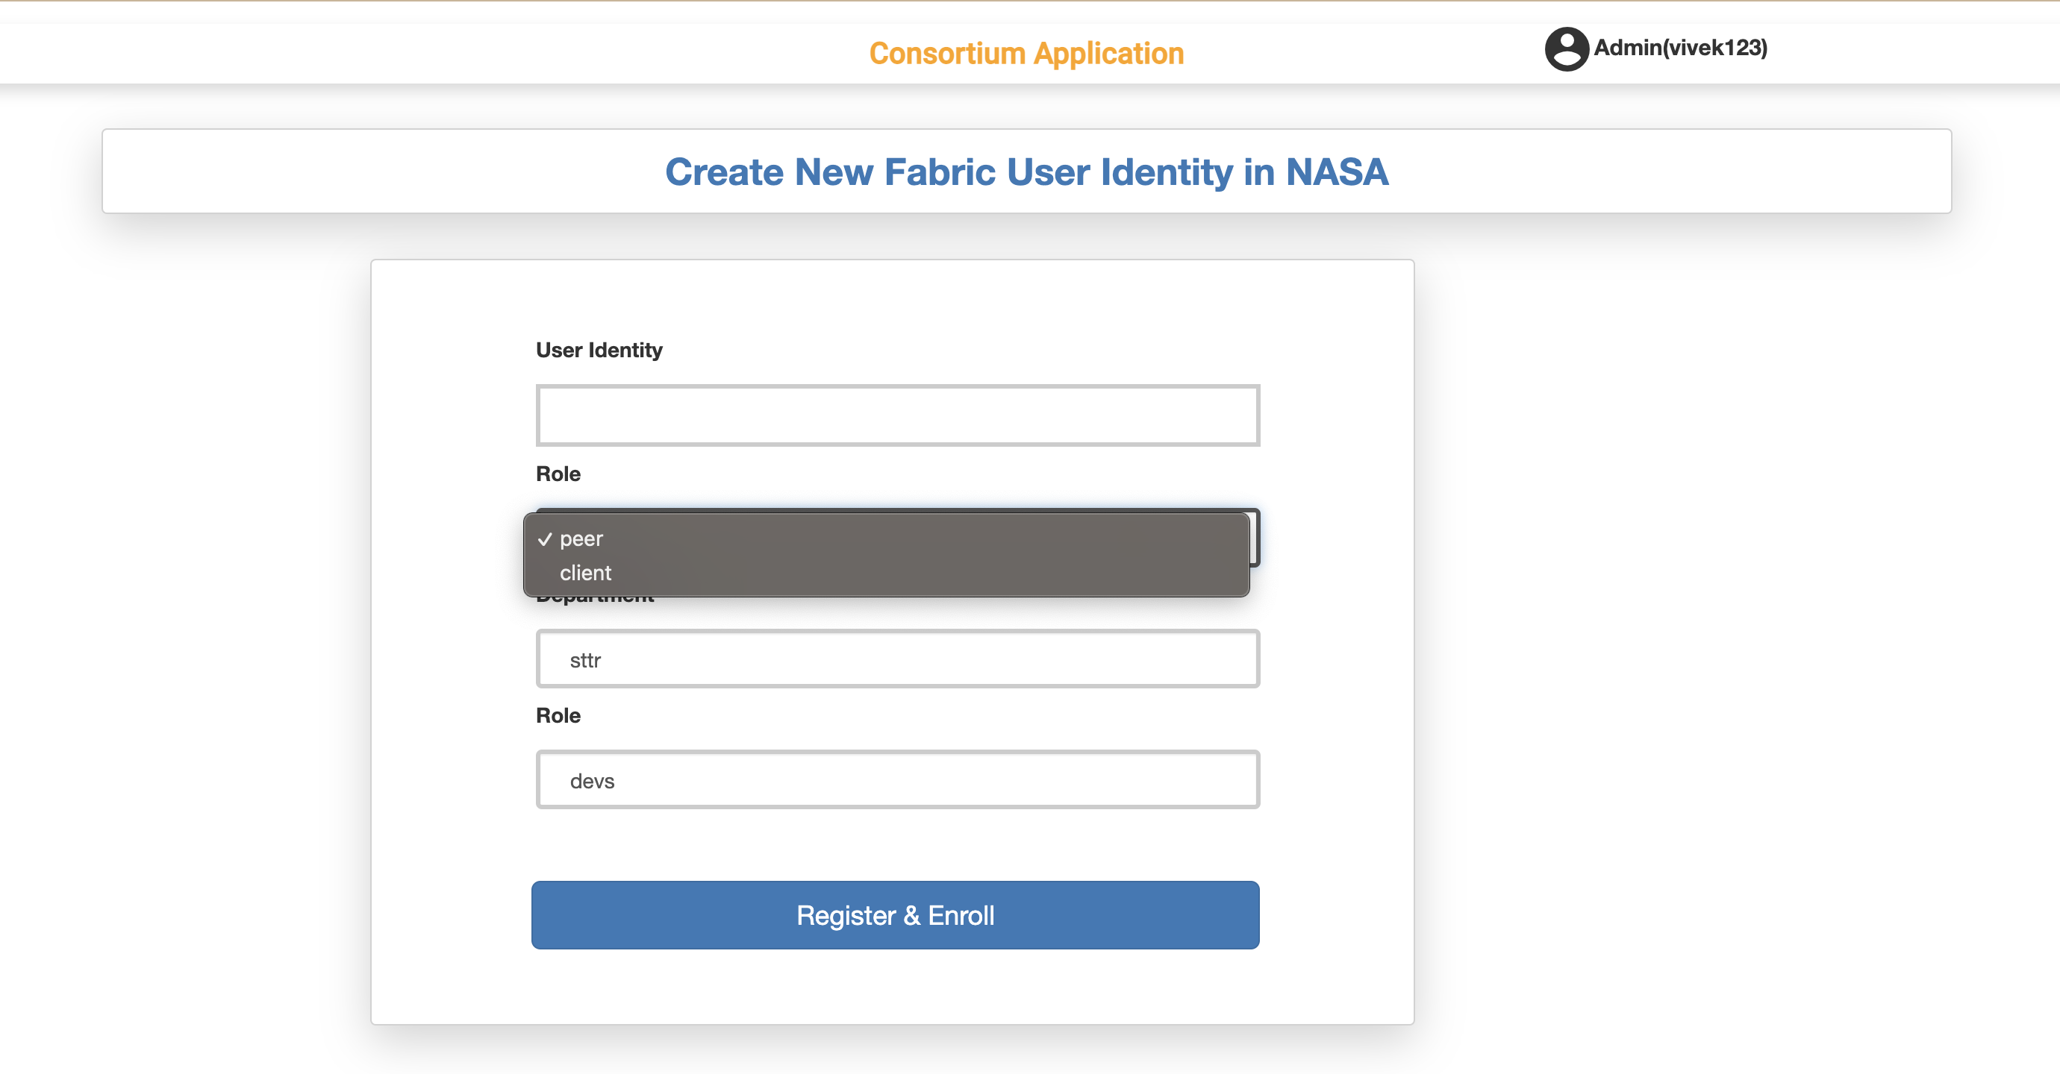
Create Fabric User Identity
11/29/2022
Full Stack Web Application For Consortium Blockchain​

Slide 17
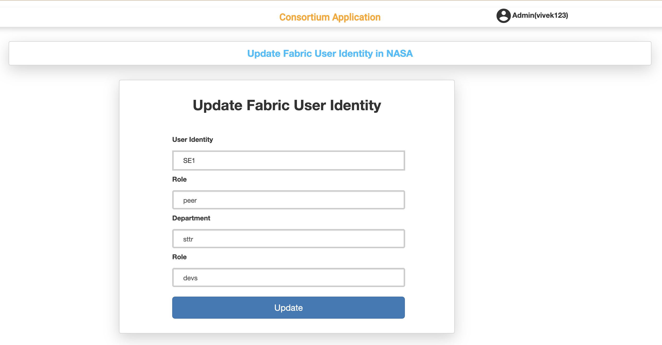
Update Fabric User Identity
11/29/2022
Full Stack Web Application For Consortium Blockchain​

Slide 18
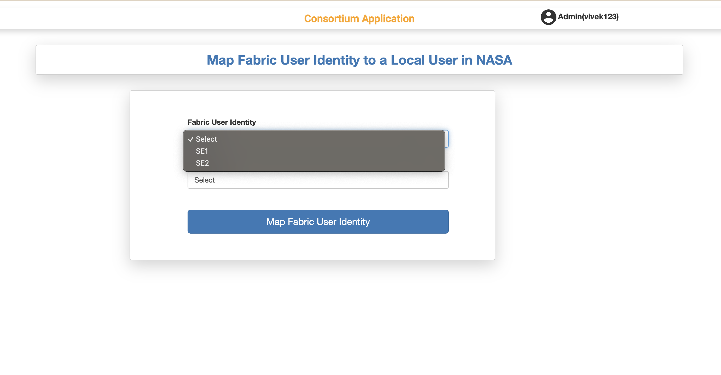
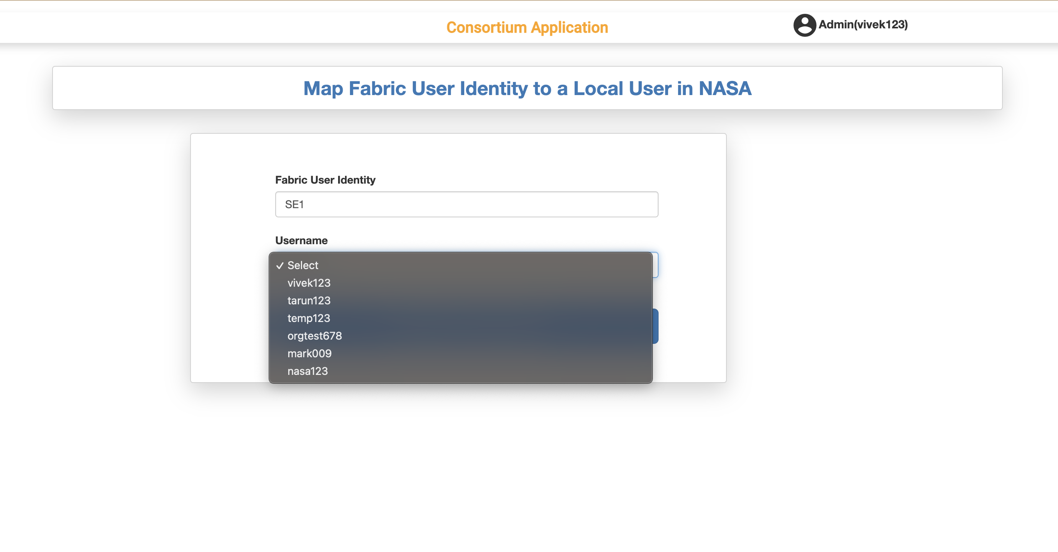
Map Fabric User Identity
11/29/2022
Full Stack Web Application For Consortium Blockchain​

Slide 19
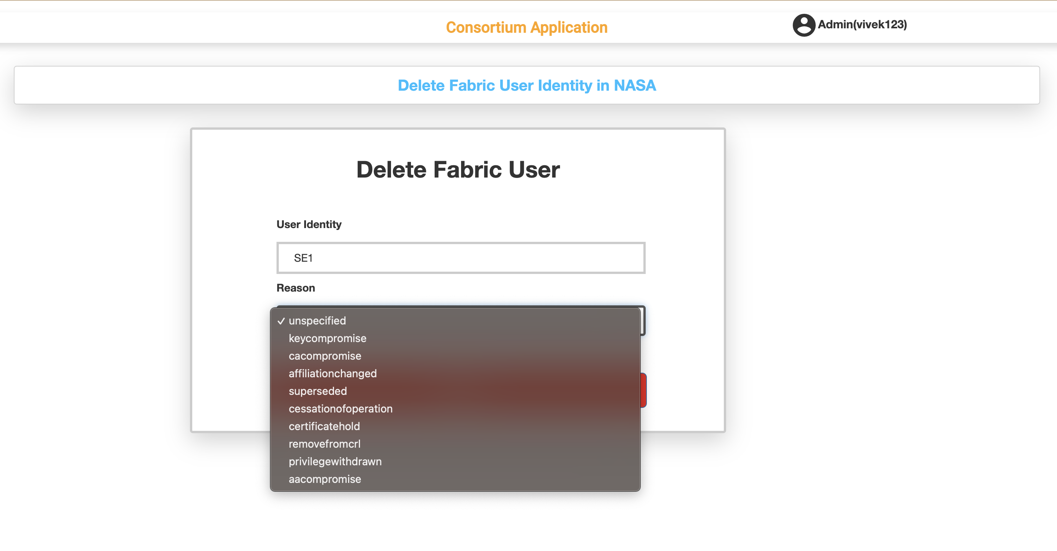
Delete Fabric User Identity
11/29/2022
Full Stack Web Application For Consortium Blockchain​

Slide 20
Create Fabric User Identity
Authenticate & Authorization
Validate the user for authenticity
Verification
Check for User identity in the wallet & PostgresDB
Register and Enroll
Register and Enroll the Fabric User Identity
Build Certificates
Build user objects for authenticating with CA
Create
Create a new record in wallet and Postgres DB
If success then user is provided with admin functionality i.e create, update, delete fabric user identities.
Check if the user role has admin authorization
11/29/2022
Full Stack Web Application For Consortium Blockchain​

Slide 21
Display Fabric User Identity List
Authenticate & Authorization
Validate the user for authenticity
Admin Identity
Pass the Admin identity to the Fabric CA
Filter
Filter the User Identities based on the organization of the admin
Display
Fetch the list from backend to the frontend using API and display the list on the UI
If success then user is provided with admin functionality i.e create, update, delete fabric user identities.
Check if the user role has admin authorization
Only Admin user can fetch the user list
11/29/2022
Full Stack Web Application For Consortium Blockchain​

Slide 22
Update Fabric User Identity
Authenticate & Authorization
Validate the user for authenticity
Verification
Check for User identity in the wallet & Postgres DB
Fetch
Retrieve fabric user identity information
Update
Update the fabric user info to in-memory wallet and Postgres DB
If success, then user is provided with update fabric user identity.
Check if the user role has admin authorization
Using Identity Service to update the identity of the user
Identity Service
Re-enroll
Re-enroll the user identity with the updated details
Else throws error
11/29/2022
Full Stack Web Application For Consortium Blockchain​

Slide 23
Delete Fabric User Identity
Authenticate & Authorization
Validate the user for authenticity
Verification
Check for User identity in the wallet & PostgresD B
Revoke Certification & Reason for deletion
Revoke the certificate of the fabric identity with the reason provided by the user
Delete
Delete the record in In-memory wallet and Postgres DB
If success then user is provided with admin functionality i.e, create, update, delete fabric user identities.
Check if the user role has admin authorization
Identity Service
After revoking the certificate call the identity service and delete the identity
11/29/2022
Full Stack Web Application For Consortium Blockchain​

Slide 24


Roles
Create
Display(get)
Fabric User Identity
Update
Delete
User
Admin
Map
Application
User
Create
11/29/2022
Full Stack Web Application For Consortium Blockchain​

Slide 25
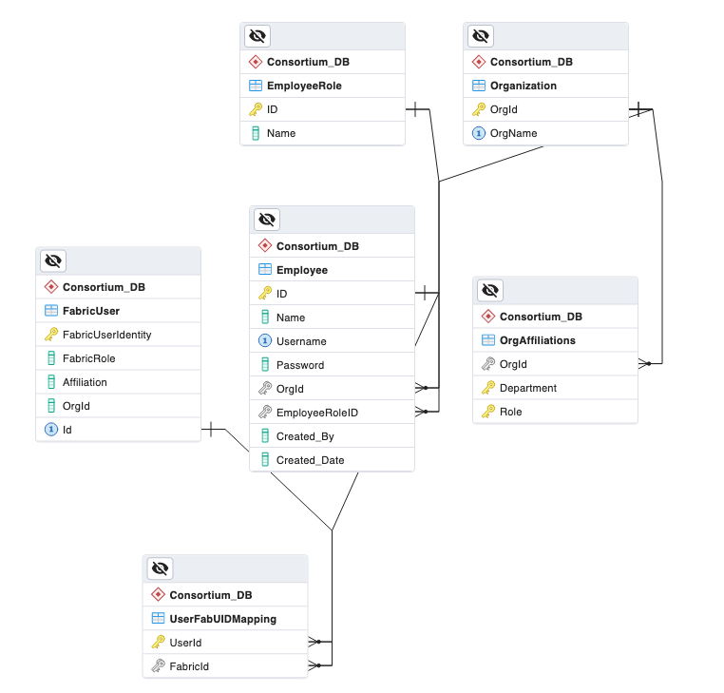
Relational Schema Diagram
11/29/2022
Full Stack Web Application For Consortium Blockchain​

Slide 26
Milestones
Setting up the initial Fabric network
Allow local admins to create users/admins for respective organizations
Role Based User Interfaces and respective functionalities for user and admin roles
UI rendering w.r.to organizations. (Each Organization has a different web page view)
Created APIs for CRUD operations for Fabric User Identities
11/29/2022
Full Stack Web Application For Consortium Blockchain​

Slide 27

Challenges
Lack of computing resources to run and test the application
Use of file system in the blockchain make data accessibility difficult
Refactoring of previous application
Synchronization of Postgres DB and Wallet (File System)
Calculating the effort needed
11/29/2022
Full Stack Web Application For Consortium Blockchain​

Slide 28

Future Scope
Store Asset's information in the Database.
Integration of smart contracts with security validation teams for data validation.
Creating end - to - end flow can help in testing the application.
Applications for other consortium applications may also be implemented if components can be refactored in a general way.
11/29/2022
Full Stack Web Application For Consortium Blockchain​

Slide 29
Conclusion
Successfully created a Full-Stack application that interacts with blockchain
APIs for CRUD operations for Fabric User Identities
Necessary data is stored in both Postgres DB and blockchain(wallet)
Endpoints created at blockchain were created in a way to handle both command line and API requests as well
11/29/2022
Full Stack Web Application For Consortium Blockchain​

Slide 30
References
https://www.npmjs.com/package/
https://material.angular.io/
https://app.dbdesigner.net/designer/
https://hackr.io/tutorials/learn-angular/
https://www.tektutorialshub.com/angular/angular-list-of-learning-resources/
https://hyperledger-fabric.readthedocs.io/en/release-1.2/prereqs.html#install-curl/
https://github.com/IBM-Blockchain/microfab/
https://angular.io/
11/29/2022
Full Stack Web Application For Consortium Blockchain​

Slide 31

Thank you
Open to questions....
11/29/2022
Full Stack Web Application For Consortium Blockchain​

